Slide 1
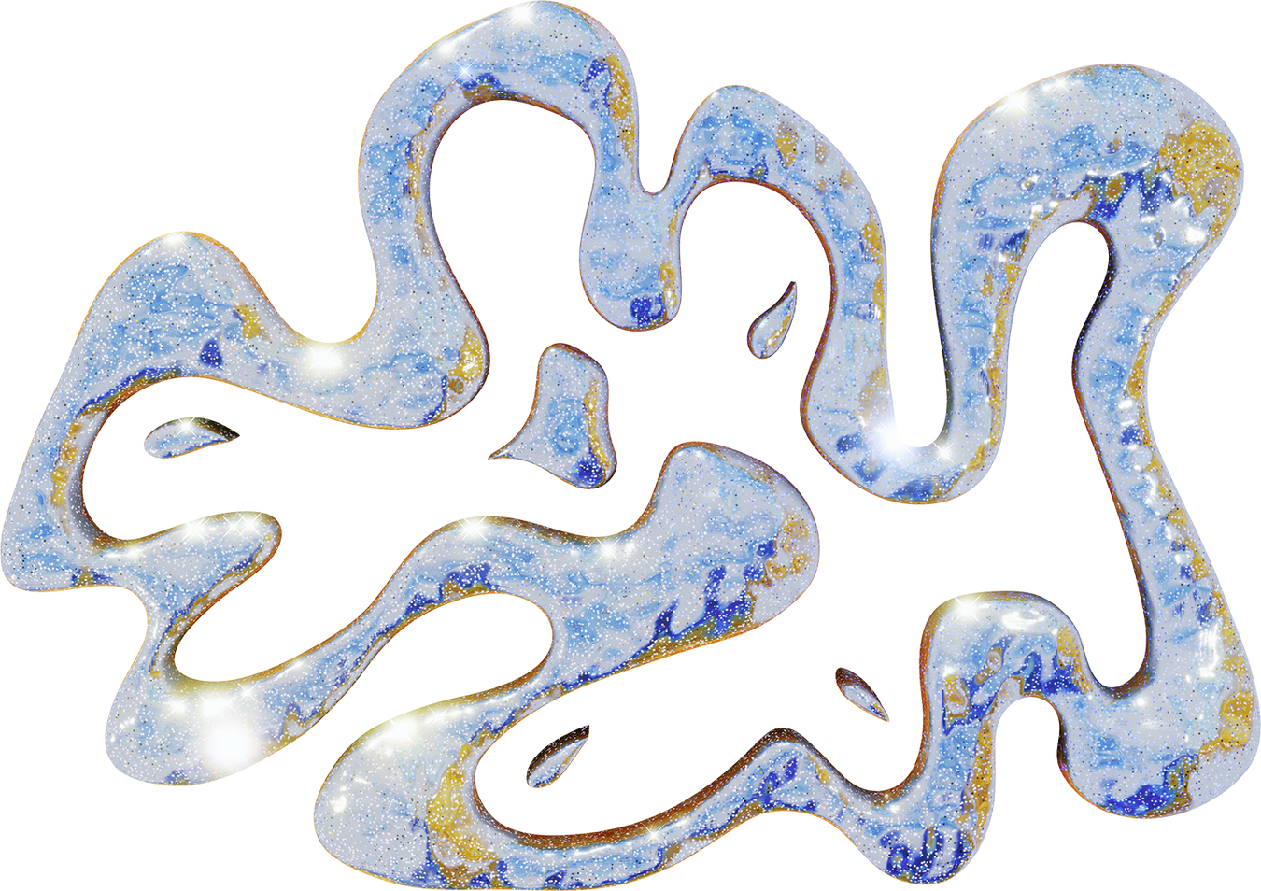

DISCRETE MATHS
PROJECT

Slide 2
PART B: NUMBER THEORY
01
02
03
04
Determine Prime Factorization
Find Gcd and LCM
Find Bezout Coefficients and their inverse
Find RSA encryption and decryption keys.

Slide 3

QUESTION 1: B
Tic-Tac-Toe, also known as "Noughts and Crosses" or "Xs and Os," is a classic paper-and-pencil game that is often played by two players. The game can be represented by a graph where all its winning probabilities, nodes and edges are represented by a graphical display.

Slide 4
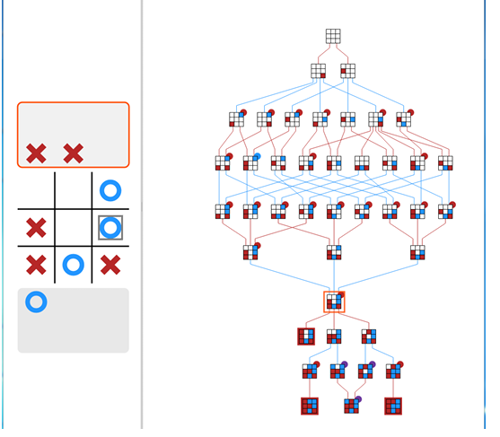
QUESTION 1: B
Tic-Tac-Toe, also known as "Noughts and Crosses" or "Xs and Os," is a classic paper-and-pencil game that is often played by two players. The game is played on a 3x3 grid, and the objective is to be the first to form a horizontal, vertical, or diagonal line of three of one's own symbols (either X or O). Players take turns marking an empty cell with their designated symbol, and the game continues until one player achieves the winning pattern or the entire grid is filled without a winner, resulting in a draw.

Slide 5

Finding Prime Factors
A while loop is used.
First it is checked if it is a factor of two using modulus.
Then another loop is used to check if it is an odd prime or not.

Slide 6
Finding GCD
A loop is added.
A temporary variable is declared in which number 1 is stored.
Then number 1 is equated to number1%number2
Them number 2 is declared equal to temp.
It is a representation of Euclidean algorithm using long division method.

Slide 7
Finding LCM
GCD function is used to calculate gcd
Then the products of numbers is divided by the gcd and the result is returned as lcm.

Slide 8
Finding Bezout Coefficients and their inverse
GCD function is used to return a tuple.
This function is called in BezoutCalculator function
This function returns s and t which are the variables that fulfil this condition.
Sa+tb=gcd(a,b);
Then inverse is calculated using formula:
ax=bmodm where a= number1, b=1,
m=number 2 and x is the inverse.

Slide 9
Finding RSA encryptions and its decryption.
Formula for RSA encryption is: C=M^e mod n where M is message and c is encrypted message
First using gcd function it is checked if gcd is 1 or not.
Then the message is converted into integers such that A=00, B=01 etc… this is converted into cypher text using modular Function and then it is combined to form an encrypted message.
During decryption, the inverse of bezout coefficients function is used to find the decryption key.

